Slide 1
Vector Fundamentals Notes

Slide 2
Vector and Direction
A vector quantity is a quantity which is fully described by both magnitude and direction.
Examples of vector quantities include displacement, velocity, acceleration, and force.

Slide 3
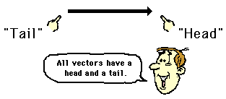
Vector Diagrams
Characteristics of an appropriately drawn vector diagram.
a scale is clearly listed
a vector arrow (with arrowhead) is drawn in a specified direction. The vector arrow has a head and a tail.
the magnitude and direction of the vector is clearly labeled.

Slide 4
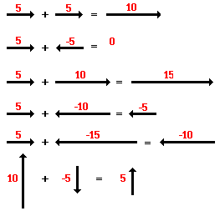
Vector Addition
Vectors in the same direction can simply be added together

Slide 5
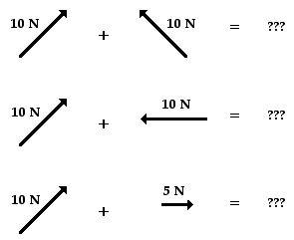
Vector Addition
Now what?

Slide 6
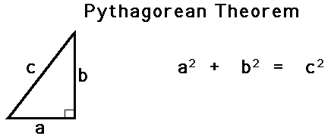
Pythagorean Theorem Method
The Pythagorean theorem is a useful method for determining the result of adding two (and only two) vectors which make a right angle to each other.

Slide 7
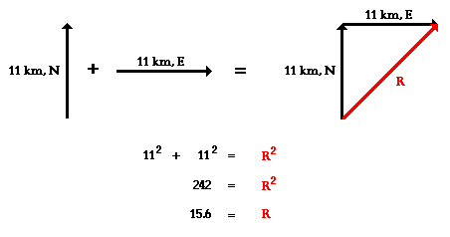
Practice
Eric leaves the base camp and hikes 11 km, north and then hikes 11 km east. Determine Eric's resulting displacement.

Slide 8
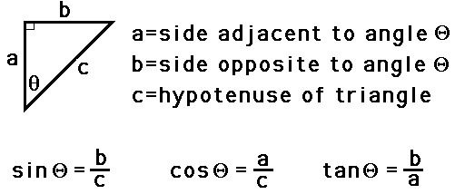
Trigonometric Method SOH CAH TOA

Slide 9
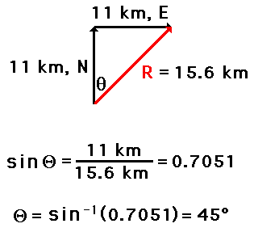
Practice
Eric leaves the base camp and hikes 11 km, north and then hikes 11 km east. Determine Eric's resulting direction relative to the start.

Slide 10
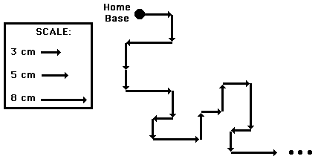
Head-to-Tail Method
Using a scaled diagram to determine the vector sum or resultant.

Slide 11
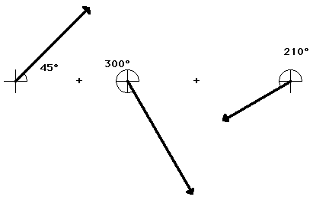
Practice
Add the vectors: 20 m, 45 deg. + 25 m, 300 deg. + 15 m, 210 deg.
SCALE: 1 cm = 5 m

Slide 12
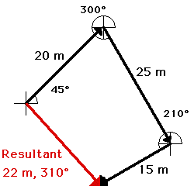
Practice
The head-to-tail method is employed as described above and the resultant is determined. The magnitude and direction is labeled on the diagram.

Slide 13
Interestingly enough, the order in which three vectors are added has no affect upon either the magnitude nor the direction of the resultant. The resultant will still have the same magnitude and direction.

